Slide 1
HUB – SATS Information
02 / 12 / 2019

Slide 2
MQ – DATA Explained
MQ Message | Data | Payload identification
NOTIFICATION | Controllo CHECK_MSG del canale MQ da T1 a T2 | \x0f
REQUEST_MSGS | ACK per ASYNC_MESSAGE o NOTIFICATION da T2 a T1 | \x0e
MQPUT_REPLY | ACK per MQPUT da T1 a T2 | \x960
MQPUT | Contiene il messaggio con i dati da T2 a T1 | \x86
ASYNC_MESSAGE | Contiene il messaggio con i dati da T1 a T2 | \x0d

Slide 3
MQ – MSG Explained
<MSG><HEADER><HDSDID>TIER2</HDSDID><HDRCID>TIER1</HDRCID><HDMGTP>SORT_RQST</HDMGTP><HDMGID>882004</HDMGID><HDEVTM>2019-11-29 17:06:40,381+01:00</HDEVTM></HEADER><BODY><VID>2019112901009431</VID><PAB><AI-WEI>193105</AI-WEI><AI-DIM>19700101010000.00|</AI-DIM><DDWE>0.64</DDWE><LE>23.5</LE><WI>18.0</WI><HE>7.6</HE><LS-WEI>Y</LS-WEI><LS-DIM>Y</LS-DIM><IU>IF01</IU><IT>2019-11-29 17:06:40,381+01:00</IT></PAB><PIB><RDID>SORTSCAN</RDID><RDST>GR</RDST><CDTP>5</CDTP><CDDT>4766366500</CDDT></PIB><PIB><RDID>SORTSCAN</RDID><RDST>GR</RDST><CDTP>3</CDTP><CDDT>2LIT80058+46000000</CDDT></PIB><PIB><RDID>SORTSCAN</RDID><RDST>GR</RDST><CDTP>1</CDTP><CDDT>JJD014600007435356581</CDDT></PIB></BODY> </MSG><
MQ Message | Significato della sigla | Description
HDMGTP | Message Typology | Tipologia di messagio: SORT_RSLT, SORT_ACK, , SORT_RQST, SORT_INST, ITEM_DATA, ITEM_RECR, LP_INST, LP_RSLT, T1_STATUS, HEARTBEAT
HDEVTM | Evaluated Time | Timestamp dell’istruzione ( a livello di messaggio MQ)
HDSDID | Sender | Tier «sender» del messaggio
HDRCID | Receiver | Tier «receiver» del messagio
HDMGID | Message ID | ID univoco del messaggio
VID | Virtual ID | ID che identifica il collo
LP_DATA | Label Printer Data | Dati dell’etichetta da stampare

Slide 4
MQ – MSG Explained – CUSTOMER data identification
MQ Message | Significato della sigla | Description
CDTP | Code Typology | Tipologia di barcode: AWB, PieceID, Totebin, HUID, CustomerID (ecc..)
CDDT | Code Data | Barcode data
Barcode Type (CDTP) | Corrispondenza
1 e 2 | PieceID
5 | AWB
7 | TOTEBIN
8 | HUID
9 | CustomerID

Slide 5





High Level Communications Schema – TIER 1 / TIER 2
SORT_RQST / SORT_RSLT
TOE
T1
T2
T3
T4
Data Protection
T5
Server TIER1
T9
T8
T7
T6
Server TIER2
GTW TIER2
MQ CLIENT
MQ CLIENT
SORT_INST / SORT_ACK

Slide 6



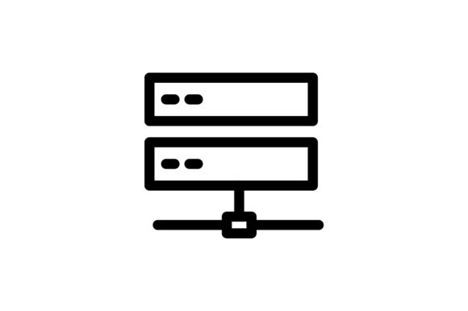
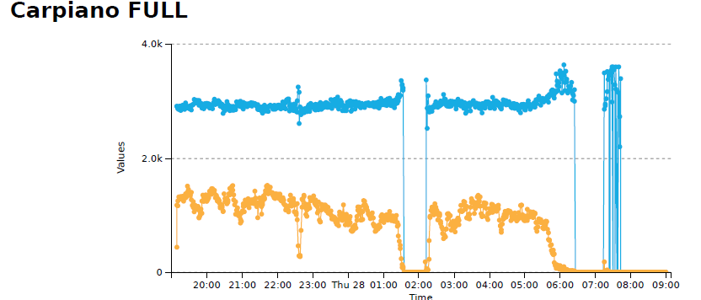
High Level Communications Schema – SNIFFER / GRAYLOG
https://visuallogita.prg-dc.dhl.com/
SPAN port
DHL Network
Over TLS
TIER2 Switch
Sniffer
Graylog Server
Static sniffer (Wireshark)
Dynamic sniffer (python + Scapy)
NXLOG for data analysis
GRAYLOG for dashboard, alert and storage
Esempio

Slide 7

MQ – Data fields from sniffer
Field Name | Description | Symbol | Note
Frame_Time | Timestamp di cattura del pacchetto da parte dello sniffer.
Frame_Time_P | Timestamp di cattura dell pacchetto precedente (stesso VID) da parte dello sniffer.
Frame_Time_DIFF_mill | Differenza con millesimi tra Frame_Time e Frame_Time_Precedente
HDEVTM | Informazione di Timestamp inserito nel pacchetto MQ dal server.
HDEVTM_P | Informazione di Timestamp del messaggio precedente (con stesso VID) inserito nel pacchetto MQ dal server.
HDEVTM_P_mill | Differenza con millesimi tra HDEVTM e HDEVTM_Precedente
T2 | T2 segment calculation time for T2 (Frame_Time – HDEVTM) |  | [2019-11-08: Actually T2 don’t use millisecond, the metric is not usefull]
T6T7 | Segment calculation time for T6 and T7 (Frame_Time – HDEVTM) |  | [2019-11-08: Actually T2 don’t use millisecond, the metric is not usefull]

Slide 8
MQ – Data fields from sniffer
Field Name | Description | Symbol | Note
COW | MQ Capacity «One Way» |  | Described in next slide

Slide 9
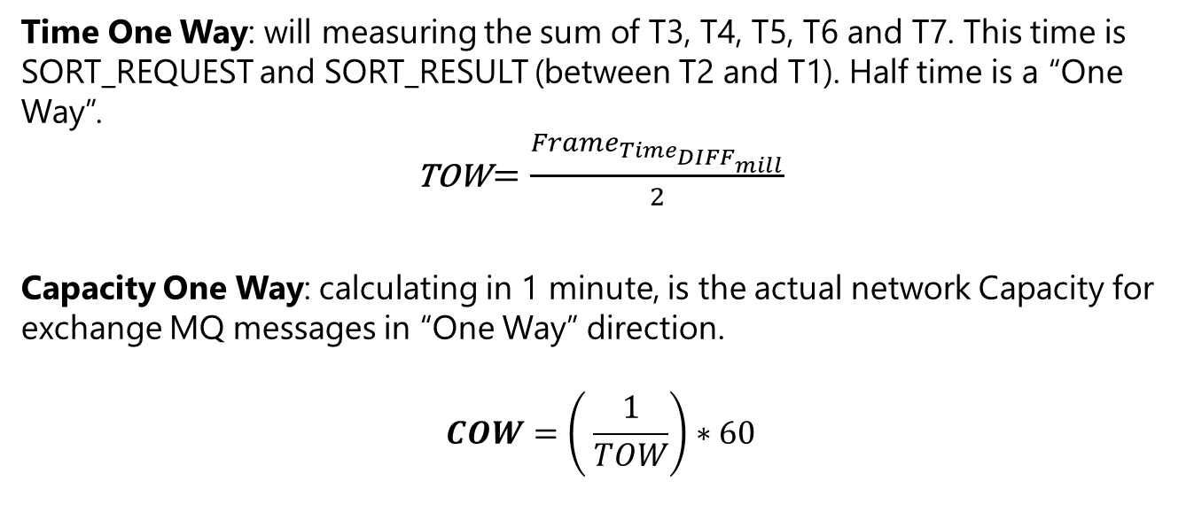
TOW and COW
_ _
((___))
[ - - ]
\ /
(' ')
(U)
Time One Way: will measuring the sum of T3, T4, T5, T6 and T7. This time is SORT_REQUEST and SORT_RESULT (between T2 and T1). Half time is a “One Way”.
TOW $=\frac{Frame_{Time_{DIFF_{mill}}}}{2}$
Capacity One Way: calculating in 1 minute, is the actual network Capacity for exchange MQ messages in “One Way” direction.
$$COW=\left( \frac{1}{TOW}\right)∗60$$

Slide 10
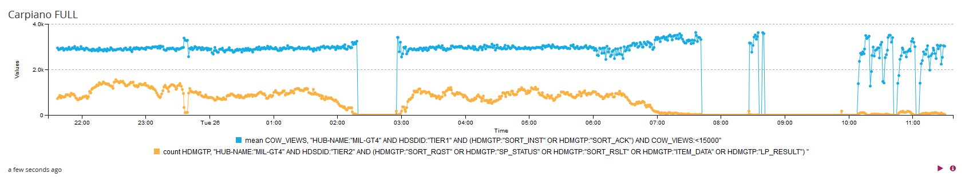
COW VIEWS
_ _
((___))
[ - - ]
\ /
(' ')
(U)
COW VIEWS QUERY FOR GRAYLOG DASHBOARD (Use two difference chart and arise in one each other):
Field for chart:
1st query: Field": "COW_VIEWS", "statistical_function": "means"
2nd query: Field": "HDMGTP", "statistical_function": "count"
Query:
HUB-NAME:"HUB-NAME" AND HDSDID:"TIER1" AND (HDMGTP:"SORT_INST" OR HDMGTP:"SORT_ACK") AND COW_VIEWS:<15000
HUB-NAME:"HUB-NAME" AND HDSDID:"TIER2" AND (HDMGTP:"SORT_RQST" OR HDMGTP:"SP_STATUS" OR HDMGTP:"SORT_RSLT" OR HDMGTP:"ITEM_DATA" OR HDMGTP:"LP_RESULT")

Slide 11
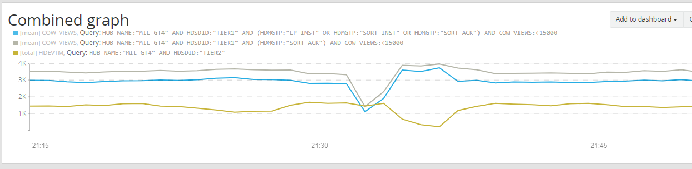
COW VIEWS Vs Total messages – Real issue
_ _
((___))
[ - - ]
\ /
(' ')
(U)
COW based only on SORT_ACK from T1
MQ Channel overload
COW based on means of SORT_ACK SORT_INST and LP_DATA from T1
All MQ message exchanged by T2 to T1

Slide 12
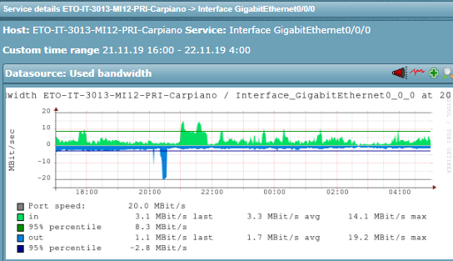
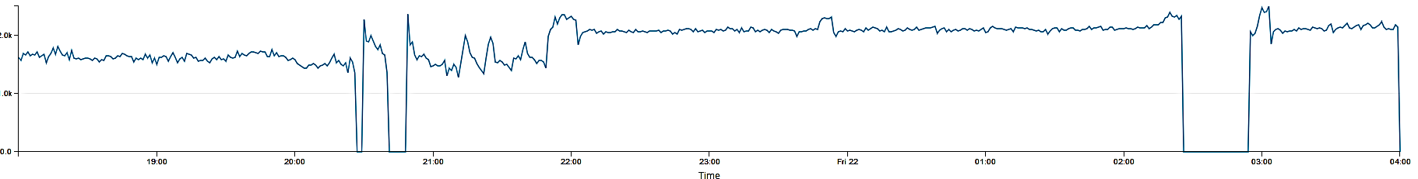
COW VIEWS Vs LAN Bandwidth – Real issue
_ _
((___))
[ - - ]
\ /
(' ')
(U)
COW Chart
Bandwidth IN
Bandwidth OUT
Bandwidth overload caused a MQ channel interruption
During sorter operation, due to single thread MQ client (T2), a tail due to saturation has been created with no messages send to T1

Slide 13
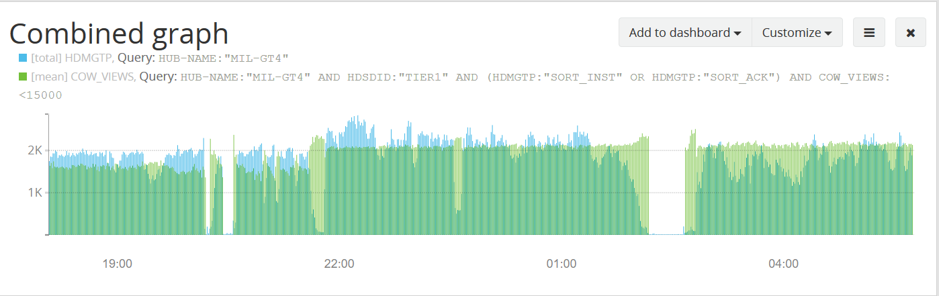
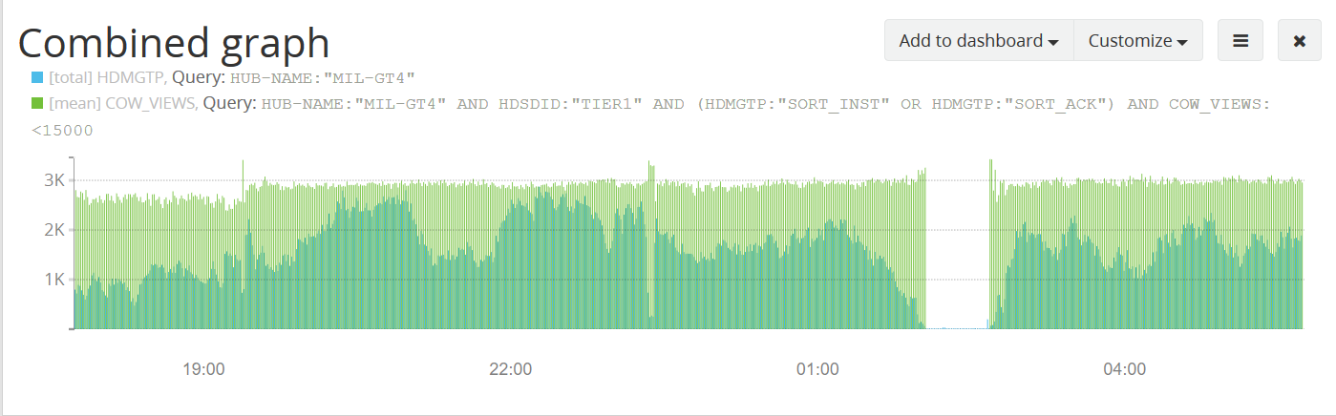
Carpiano - 21 Novembre
Carpiano - 25 Novembre

Slide 14
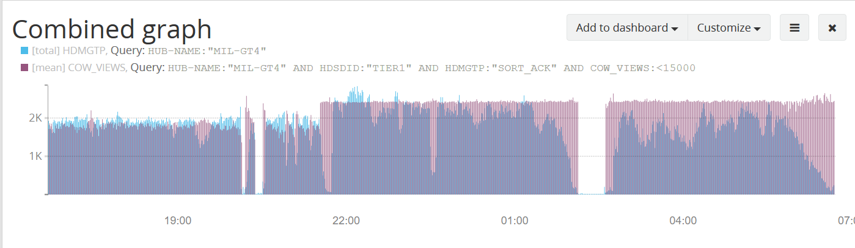
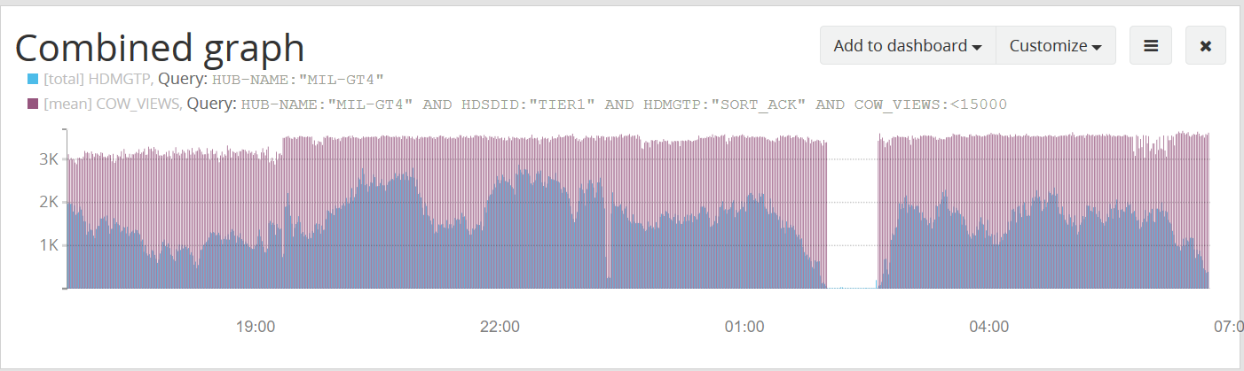
Carpiano - 21 Novembre
Carpiano - 25 Novembre

Slide 15
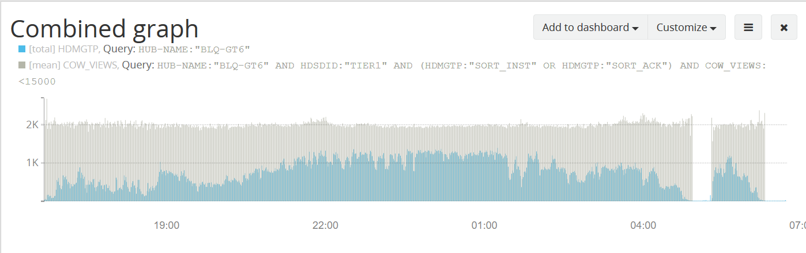
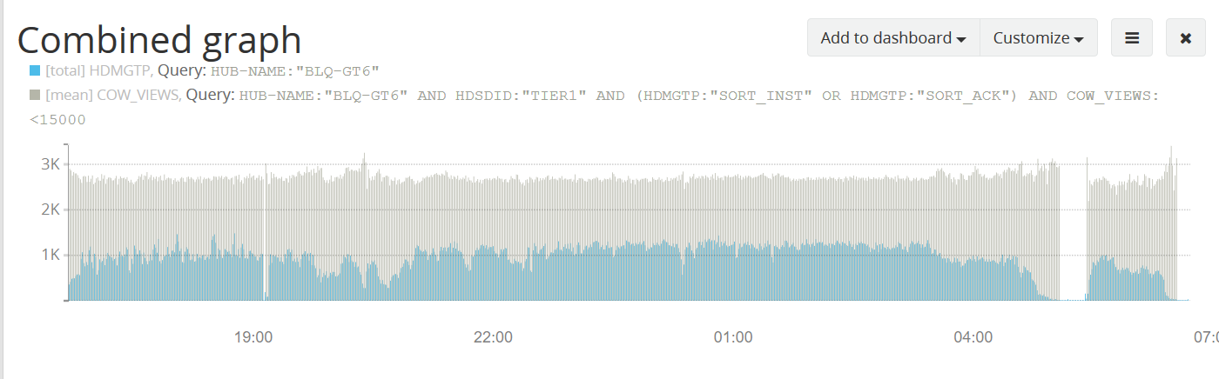
Bologna - 21 Novembre
Bologna - 25 Novembre

Slide 16
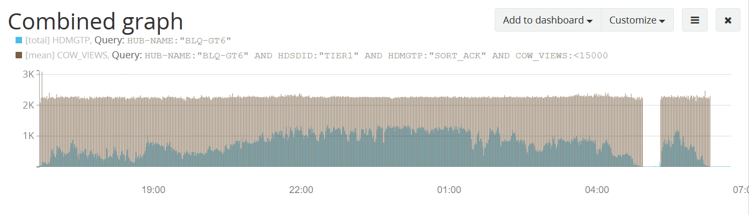
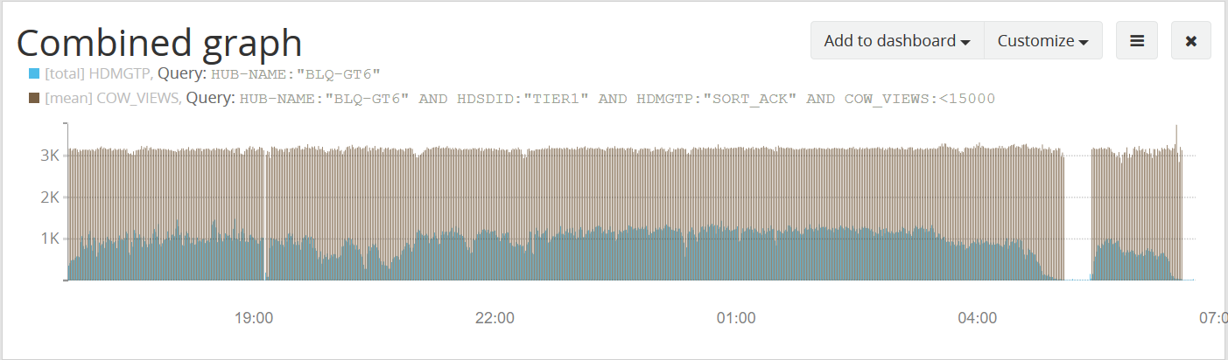
Bologna - 21 Novembre
Bologna - 25 Novembre

